Slide 1
L13 - Final Stages
Initial development
first functioning version
software changes
Evolution
evolution ends
servicing patches
Servicing
servicing discontinued
Phase-out
switch-off
Close-down
© 2012 Václav Rajlich Software Engineering: The Current Practice Ch. 15

Slide 2
End of Software Evolution
Software stabilization
Code decay
Business decision
© 2012 Václav Rajlich Software Engineering: The Current Practice Ch. 15

Slide 3
Software stabilization
Software domain and technology of the project are stable
Volatility of stakeholder knowledge is the only reason for evolution
  stakeholders explore the problem by trial-and-error
Stakeholder knowledge reaches a point of stability
  further substantial changes are unnecessary
© 2012 Václav Rajlich Software Engineering: The Current Practice Ch. 15

Slide 4
Example stabilization
Real-time systems
  for example a car ignition
Domain is the specific car engine
  once produced, it does not change
  domain is completely stable
Stakeholders learning is the only reason for evolution
  once the learning is completed there is no reason for further evolution.
© 2012 Václav Rajlich Software Engineering: The Current Practice Ch. 15

Slide 5
Code decay
Software is not material
  not subject to wear and tear
Its structure decays under the impact of software changes.
© 2012 Václav Rajlich Software Engineering: The Current Practice Ch. 15

Slide 6
Symptoms of code decay
Increased difficulty of software changes
  confused contracts between suppliers and clients
  concept extensions delocalized into several classes
  unexpected or illogical coordination among the classes
Decreased quality
  an increase in the presence of bugs
© 2012 Václav Rajlich Software Engineering: The Current Practice Ch. 15

Slide 7
Decayed structure of software
Does not support concept location
  code does not have meaningful identifiers for grep
  does not have clean contracts for the dependency search
Does not support unit testing, code inspection
  the changes become increasingly difficult and risky
© 2012 Václav Rajlich Software Engineering: The Current Practice Ch. 15

Slide 8
Loss of knowledge
Programmers must understand the domain
They also must understand the architecture, the algorithms, and data structures of the code
Refactoring also requires a thorough knowledge of software
If that knowledge is lost, even refactoring is no longer possible and the system further decays
© 2012 Václav Rajlich Software Engineering: The Current Practice Ch. 15

Slide 9
Knowledge transfer
Part of the knowledge is recorded in program documentation,
Knowledge is of such a size and complexity that a complete recording is impractical
Tacit individual or group knowledge
  tacit knowledge is constantly at risk.
  software engineers who are leaving the project are taking their knowledge with them
© 2012 Václav Rajlich Software Engineering: The Current Practice Ch. 15

Slide 10
Loss of knowledge through cultural change
There are programs still in use that were created a half century ago.
  created in a context of old hardware
  written in obsolete languages
  elaborate algorithms deal with limitations
  programmers who created these programs are no longer available
  new programmers may not understand old techniques and old culture
© 2012 Václav Rajlich Software Engineering: The Current Practice Ch. 15

Slide 11
Knowledge gap
Decay makes the code more complicated
Knowledge necessary for evolution increases
Gap between the knowledge of the team and the growing complexity of software may become too large
  the software evolvability is lost
  the system slips into servicing
© 2012 Václav Rajlich Software Engineering: The Current Practice Ch. 15

Slide 12
Management decision
Managers decide that software does not deserve new investments
It still retains a value to its current users
  the purpose of the servicing is to protect that residual value
Threats to that value can come from
  the bugs that surface during the use
  changes in the technology or domain to which the software must adapt
© 2012 Václav Rajlich Software Engineering: The Current Practice Ch. 15

Slide 13
Example Y2K
Wrong assumption about the life-span
  lifespan will end before January 1, 2000
Year represented by two digits
  February 23, 1978 = 02, 23, 78
  January 1, 2000 = 01, 01, 00
    the programs interpreted this as January 1, 1900
    correction became a huge worldwide concern
    The change protected software value beyond January 1, 2000 deadline.
© 2012 Václav Rajlich Software Engineering: The Current Practice Ch. 15

Slide 14
Wrappers
Wrapper
Wrapping deficient functionality
Structure further deteriorates
New Precondition
New Postcondition
Old Code
© 2012 Václav Rajlich Software Engineering: The Current Practice Ch. 15

Slide 15
Processes
SIP, AIP
No need for postfactoring
  Changes are corrective and adaptive
© 2012 Václav Rajlich Software Engineering: The Current Practice Ch. 15

Slide 16
Phase-out
No new updates to the software
  if software is still in use, the users must work around the deficiencies.
    work-around.
    owners of the software still may provide a help
    the bulletins that describe how to work around the known software bugs
Management may slowly withdraw servicing
  Gradual start of phase-out
© 2012 Václav Rajlich Software Engineering: The Current Practice Ch. 15

Slide 17
Close-down
Users stop using the software
  work done by the system may no longer be needed
  software was already in the stage of phase-out but a new problem appeared and pushed the software over into close-down
  a new and better software replaced the old one.
© 2012 Václav Rajlich Software Engineering: The Current Practice Ch. 15

Slide 18
Phases of close-down
Users who used the old system must be retrained to use the new system
Persistent data need to be preserved
  customer records, birth certificates, student transcripts
  the old data are migrated to the new system
    may involve data conversion
    the quality and integrity of this conversion must be evaluated
© 2012 Václav Rajlich Software Engineering: The Current Practice Ch. 15

Slide 19
Software Reengineering
Initial development
first running version
software changes
Evolution
reengineering
Evolution ends
servicing patches
Servicing
servicing discontinued
Phase-out
switch-off
Close-down
© 2012 Václav Rajlich Software Engineering: The Current Practice Ch. 15

Slide 20
Management options
Decayed code
Maintain status quo
Retire system
Reengineer
© 2012 Václav Rajlich Software Engineering: The Current Practice Ch. 15

Slide 21
Reengineering
Reengineering = reverse engineering + forward engineering
Reverse engineering
  Code → abstraction
    Design
    Knowledge
Forward engineering
  Abstraction → code
© 2012 Václav Rajlich Software Engineering: The Current Practice Ch. 15

Slide 22
Reengineering
extracted
knowledge
new
design
old
code
new
code
old
new
© 2012 Václav Rajlich Software Engineering: The Current Practice Ch. 15

Slide 23
Reengineering process
Whole-scale
  Puts big resources at risk
  Tolerance of the users is low
    Users expect the same functionality
  Systems are huge
    Whole-scale reengineering takes too long
    Maintaining two systems in parallel
    Expensive
    May be obsolete before being used
Incremental
© 2012 Václav Rajlich Software Engineering: The Current Practice Ch. 15

Slide 24
Incremental reengineering
Results are immediate and concrete
  less risk
Flexible
  efforts can be redirected
Justification is easier
Disadvantages
  preserves some of the old structure
© 2012 Václav Rajlich Software Engineering: The Current Practice Ch. 15

Slide 25
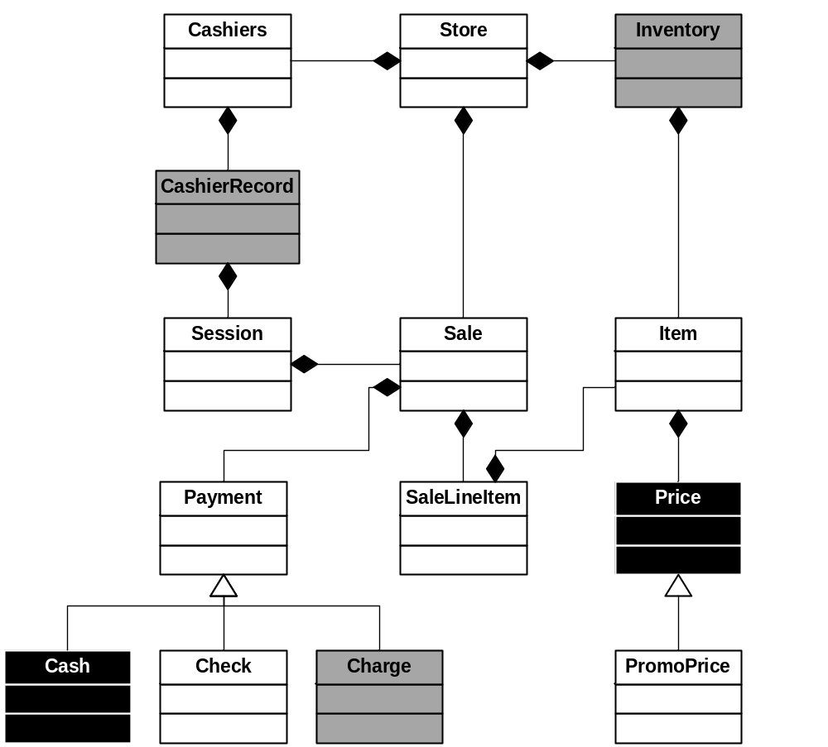
Heterogeneous software
© 2012 Václav Rajlich Software Engineering: The Current Practice Ch. 15

Slide 26
Reengineering interleaved with evolution
The product backlog consists of the following tasks:
  servicing requests
    require only small changes
  evolutionary requests
    involve evolvable modules
    involve decayed modules
  requests to reengineer decayed modules
Processes: SIP, AIP
© 2012 Václav Rajlich Software Engineering: The Current Practice Ch. 15

Slide 27
Advantages
Avoids disruption of the user’s routine
  results of the reengineering are immediate, concrete, and limited in scope
  if anything goes wrong, the efforts can be reversed and redirected
Justification to reengineer is easier
  the expenses of the individual reengineering tasks are limited.
© 2012 Václav Rajlich Software Engineering: The Current Practice Ch. 15

Slide 28
Four classes of components
Software = business rules
Data
Platforms
  hardware, operating systems, compilers …
Support for interaction with the program
  GUI, sensors, …
© 2012 Václav Rajlich Software Engineering: The Current Practice Ch. 15

Slide 29
Gateways
Support coexistence of the old and new parts in the same system
Map the functionality and format of messages between new and old
© 2012 Václav Rajlich Software Engineering: The Current Practice Ch. 15

Slide 30
Example
interface
gateway
Old software
New software
gateway
Old data
New data
© 2012 Václav Rajlich Software Engineering: The Current Practice Ch. 15

Slide 31
Redevelopment
Code is rewritten by the programmer
  the old code is no longer usable
unit or functional tests are preserved
  guarantee that the old and new code has the same functionality.
© 2012 Václav Rajlich Software Engineering: The Current Practice Ch. 15

Slide 32
Preserve the knowledge
The knowledge of the domain is often collected in the code
It is not recorded anywhere else
  example of such knowledge is the knowledge how to calculate insurance premiums
This knowledge must not be lost
  it is extracted from the old program and used in the new one
© 2012 Václav Rajlich Software Engineering: The Current Practice Ch. 15

